Slide 1

Next Generation Vending Machine System
Empowered by real-time data tracking.

Slide 2
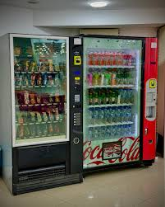
Problem descrıptıon
Why Traditional Vending Machines Are Failing ?
Only one product can be purchased at a time
Products may be out of stock , but payment still accepted
No live stock tracking
Outdated button-based interfaces
No solution for people with special needs (vegan, gluten-free etc.)
i.e. the system victimizes both the user and the company.

Slide 3
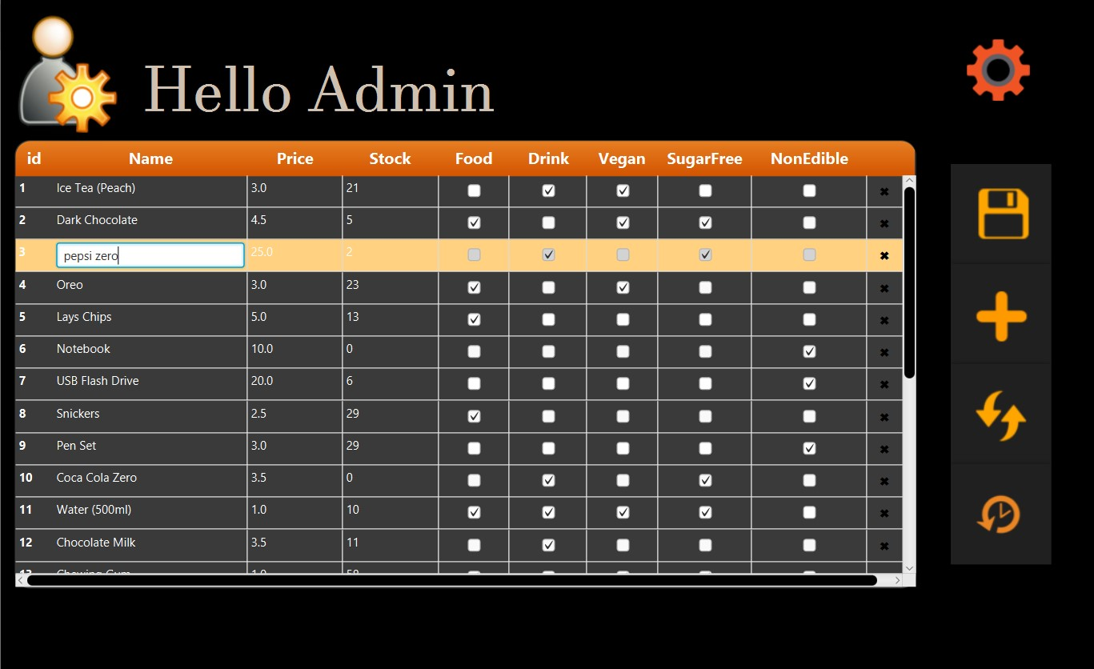
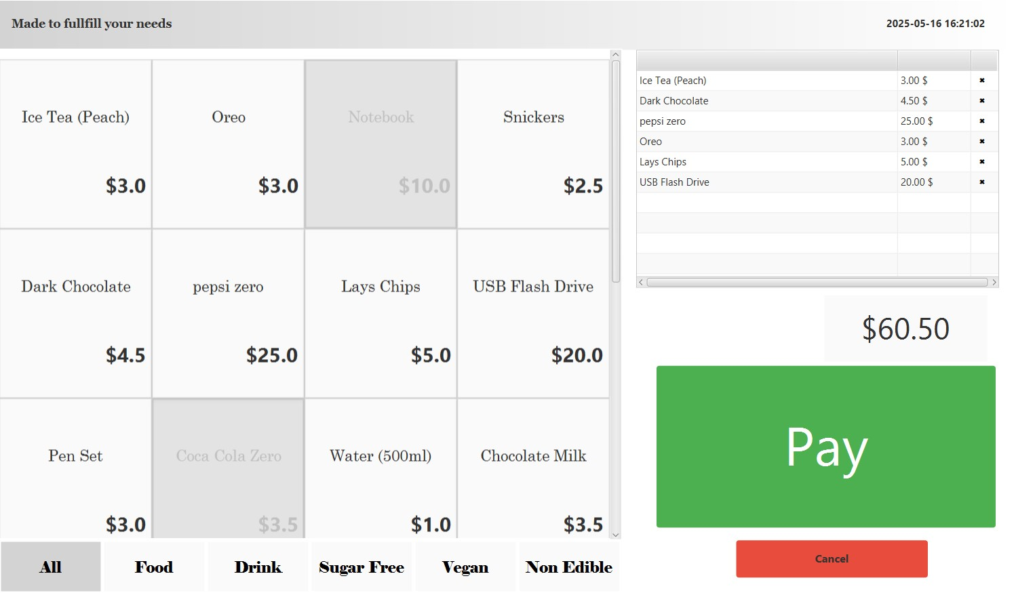
OUR SOLUTION
Screen-based modern system
Real-time stock tracking via cloud connection
Out of stock products can not be sold.
Up to 10 products can be purchased at a time (basket approach)
Filterable system according to specific needs(vegan, sugar-free etc.)
Transaction history access

Slide 4
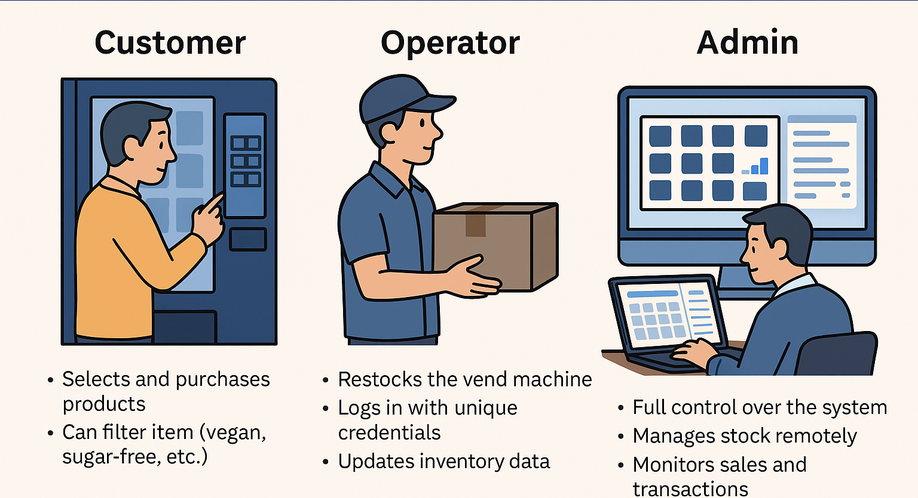
Who uses this system

Slide 5

WHAT ADMIN DOES?
Admin has full control over the system

Slide 6
Admin can;
View the full transaction log, including detailed purchase information (date, time, products, total cost)
Reset the transaction log when necessary
Add or remove operators, and modify their usernames and passwords
Access the database with full, unrestricted authority
Add new products to the system
Delete existing products
Update product details such as names, prices, stock quantities, and categories

Slide 7
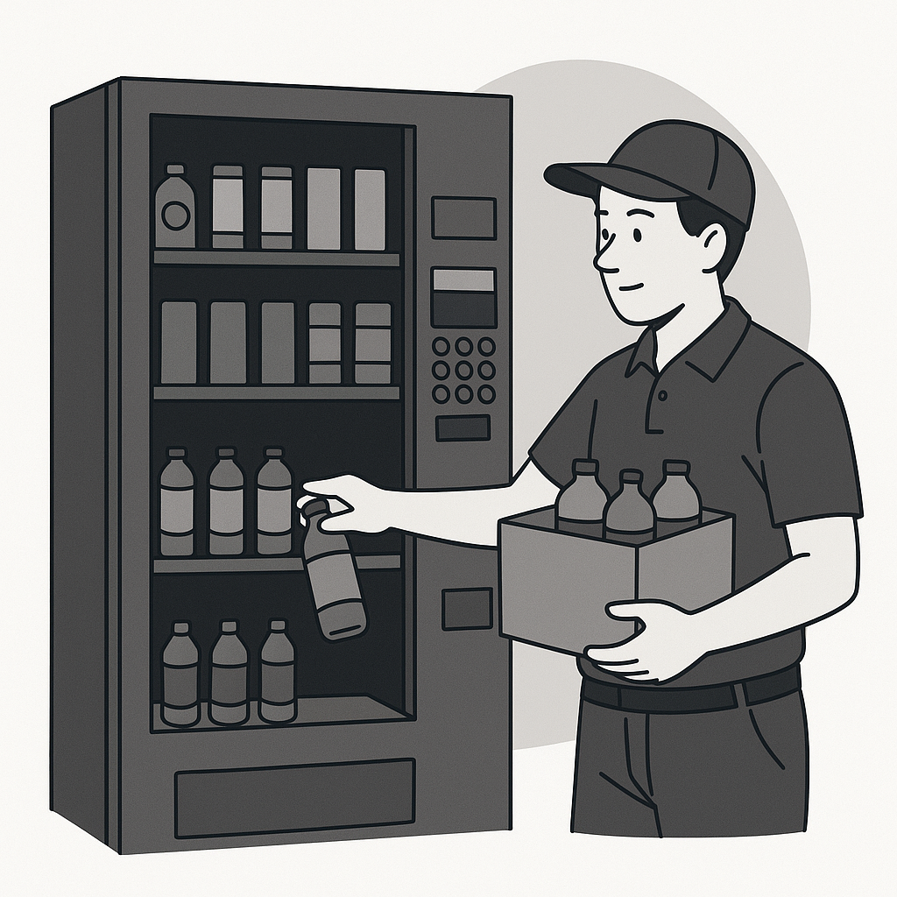
WHAT Operator
DOES?
Operators are responsible for updating stock data after physically restocking the vending machine.

Slide 8

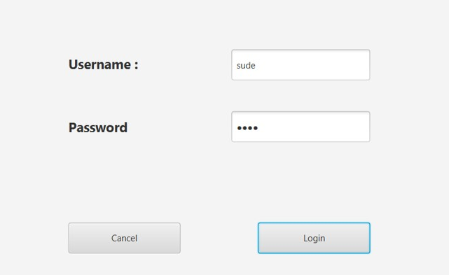
Each operator uses a secure login authorized by the admin
The only action operators can perform is updating stock information.
Their access to the database is strictly limited to stock updates only.

Slide 9

Happy customers
Nobody deserves to be tricked by an empty stocks.

Slide 10
Let’s Dive Into the Project Codebase
Used Technologies:
JavaFX
For building a modern and responsive user interface
PostgreSQL
Stores product, transaction, and operators data securely
Enables real-time stock tracking.
Apache Ant
Full control over the build process.
Simplicity and transparency
Portability

Slide 11

System Overview – Two Main Modules
Admin
User
Only used by Admin
Used by both; Customer and Operator
DATABASE
The project is designed with two distinct user interfaces, each serving a unique role.

Slide 12
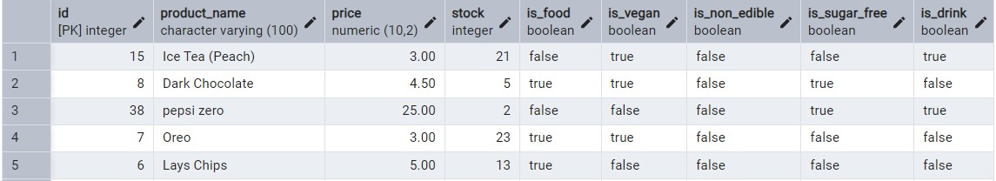
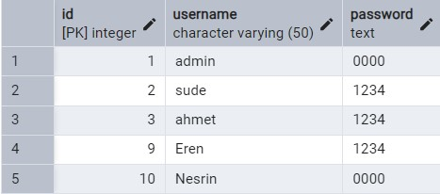
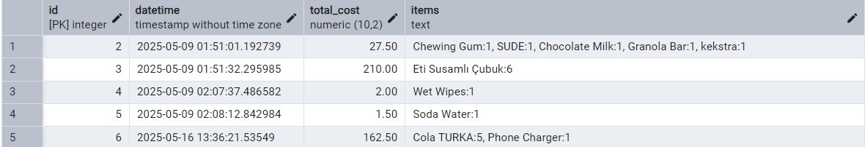
THREE TABLES IN DATABASE
PRODUCTS
OPERATORS
TRANSACTIONS

Slide 13
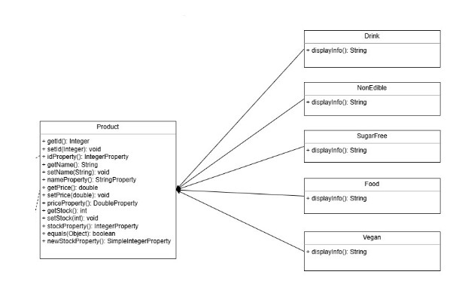
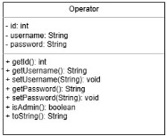
Correspondıng java classes
Abstarct.

Slide 14
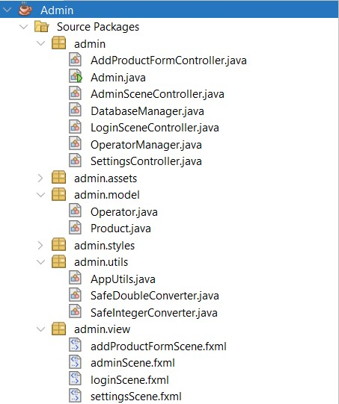
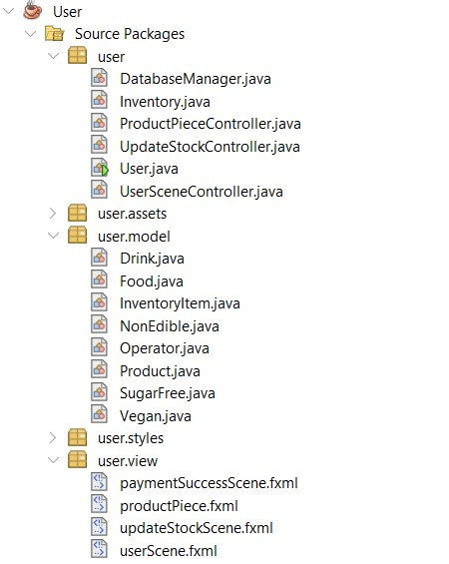
STRUCTURE OF the project

Slide 15
Database Manager
Operator Manager
DATABASE
Admin

Slide 16
INVENTORY
Database Manager
User
DATABASE

Slide 17
INVENTORY
Inventory Item
product: Product
stock : int
◆──────▶

Slide 18
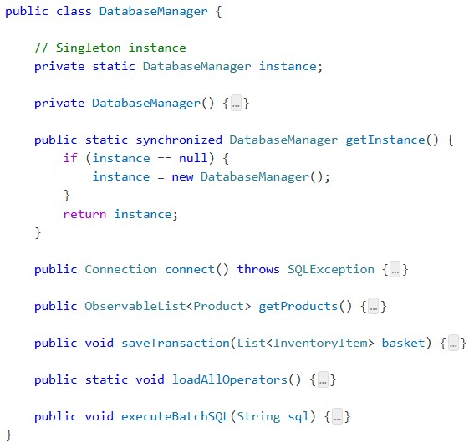
Optimized & Cost-Efficient
Singleton Pattern ;
Ensures a single shared instance throughout the application
Prevents redundant connections and connect only for once.
Batch Execution via executeBatchSql();
Collects SQL commands and sends them to cloud in a single optimized query.

Slide 19
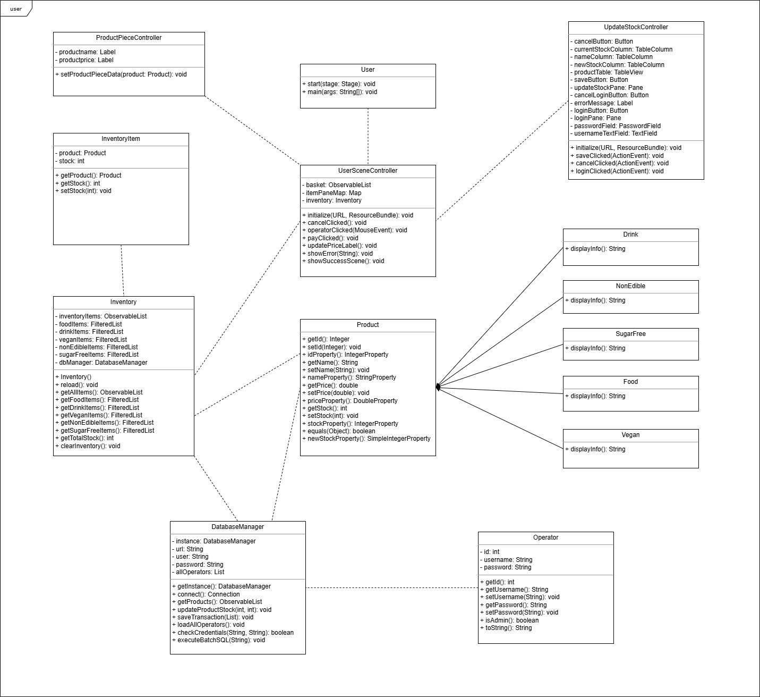

Slide 20
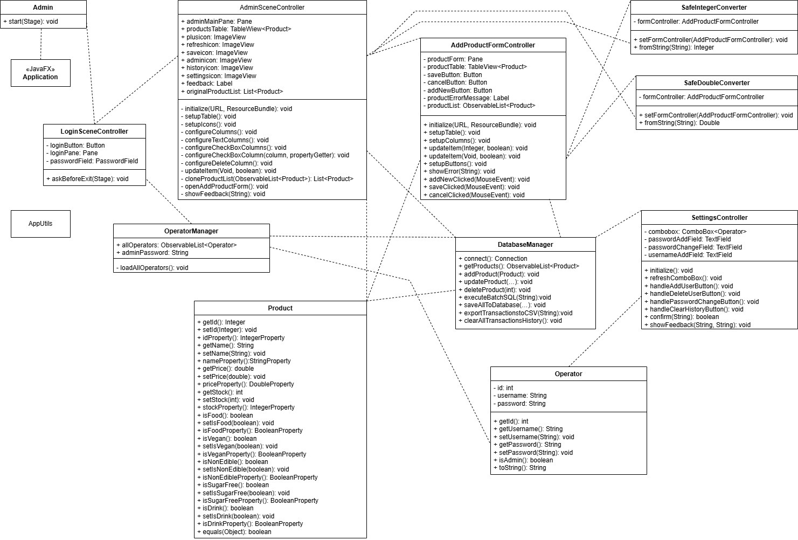

Slide 21
What we achıeved
Developed a professional real-world system which is run on both cloud and local environments(PostgreSQL + optional Cloud SQL setup)
Built with clear modular structure, codebase is readable and easy to extend..
Applied Object-Oriented Programming principles effectively
Strong focus on Single Responsibility Principle (SRP); Every class and method serves one clear purpose.
Optimized database connections with algorithmic approaches.
At every layer of the system, we thought like real developers

Slide 22
Enough theory
let’s see it in action..

